Slide 1
Exploratory Data Analysis
First Responder Sites – Fire Incident Data

Slide 2
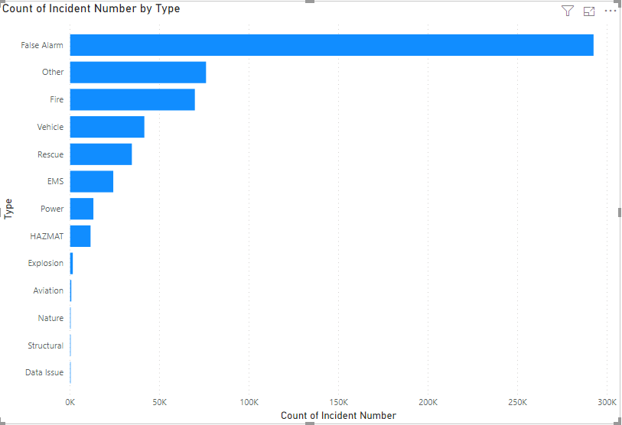
Large Number of False Alarms

Slide 3
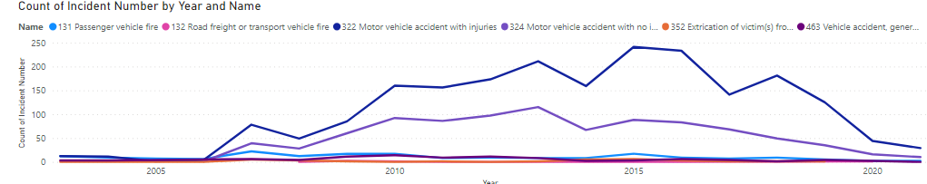
Vehicle Related Incidents Spike in 2006 to 2007

Slide 4
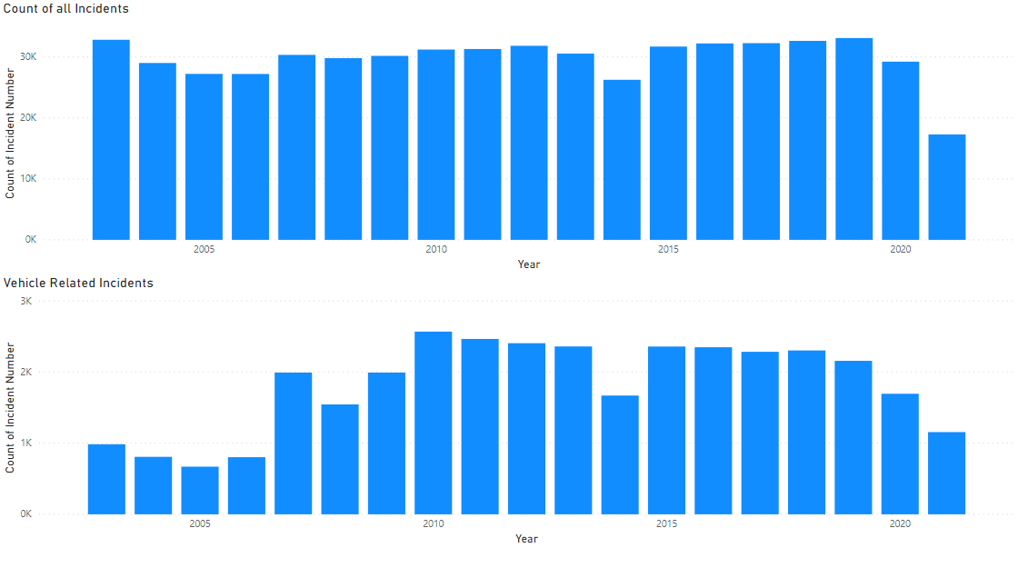
Vehicle Related Incidents Spike in 2006 to 2007
No explanation found (yet), could be the way incidents were coded changed as the number of overall incidents remains relatively constant

Slide 5
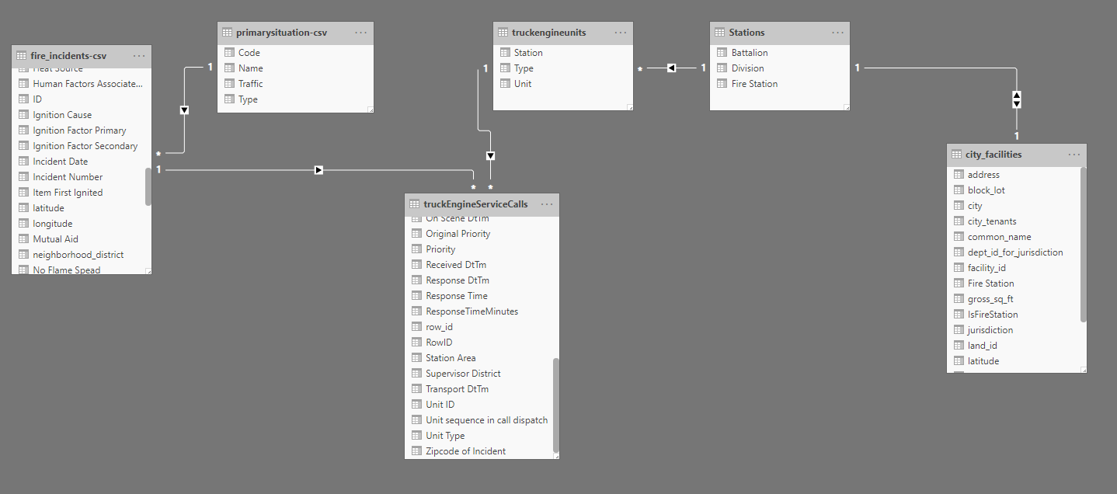
Initial ER Discovery
*Not depicted, a fire station resides within a Battalion.
**Most fire stations serve one neighborhood, but some serve multiple

Slide 6
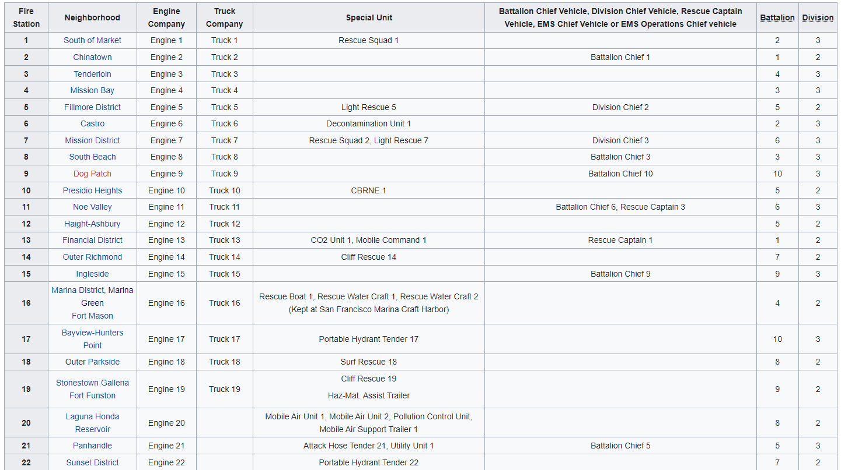
Unit Naming Convention Links Unit to Station
https://en.wikipedia.org/wiki/San_Francisco_Fire_Department

Slide 7
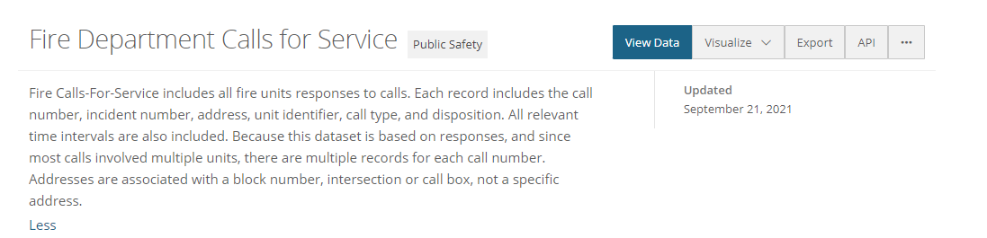
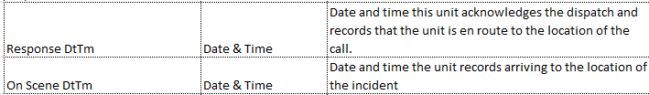
Calls for Service Dataset
Calls for Service Dataset has a more granular and specific record of fire unit’s time to respond
Dataset is large, 5M rows, 2GB file size
The difference in these two metrics could be used to denote the “travel time” of an individual unit

Slide 8
Station Analysis Approach
Collected unit and station data and logically tied individual Units to their respective stations (based on naming convention supported by Wikipedia article)
Calculated “Travel Time” metric based on “Response Time” and “On Scene time”
Filtered only Engine and Truck units from the Calls for Service Data
Filtered by Response Times > 9 minutes to find long travel times
Aggregated the Count of Long Travel times per Unit to the station level
Presented on a map visually by station location

Slide 9
